Slide 1
Last Note
Dithering
Threshold
Brightness
Thresholding
Pattern
Diffusion
Color dithering

Slide 2
This Note
Image Manipulation
Point operations
Neighboring operations: image mapping
NPR
Warping and NPR details in Prof. Yao’s Digital Meshes.
Filtering details in Prof. Hua’s class and Extra Note 1
Project 1: 10/13 Due and Demo

Slide 3
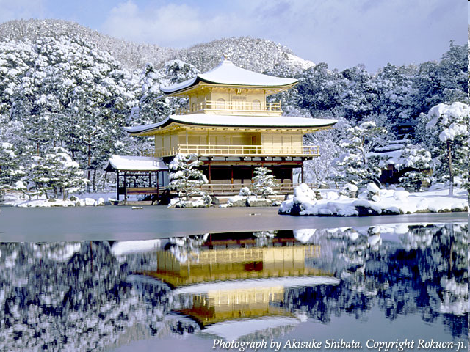
Image Manipulation
We have now looked at basic image formats and color, including transformations of color
Next, operations involving image resampling
Scaling, rotating, morphing, …
But first, we need some signal processing
Also important for anti-aliasing, later in class

Slide 4
Discussion
Definition of pixel operations.
Give various pixel operators?

Slide 5
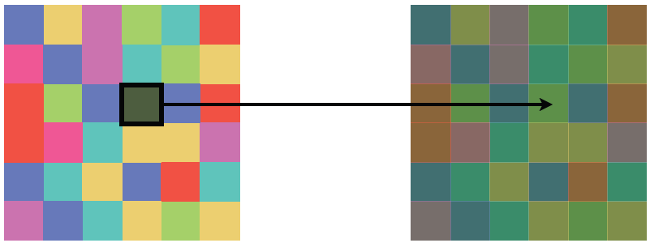
Pixel Operations

Slide 6
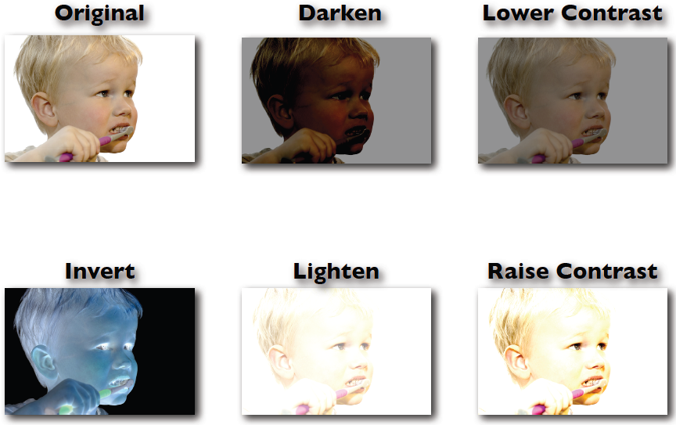
Point Processing

Slide 7
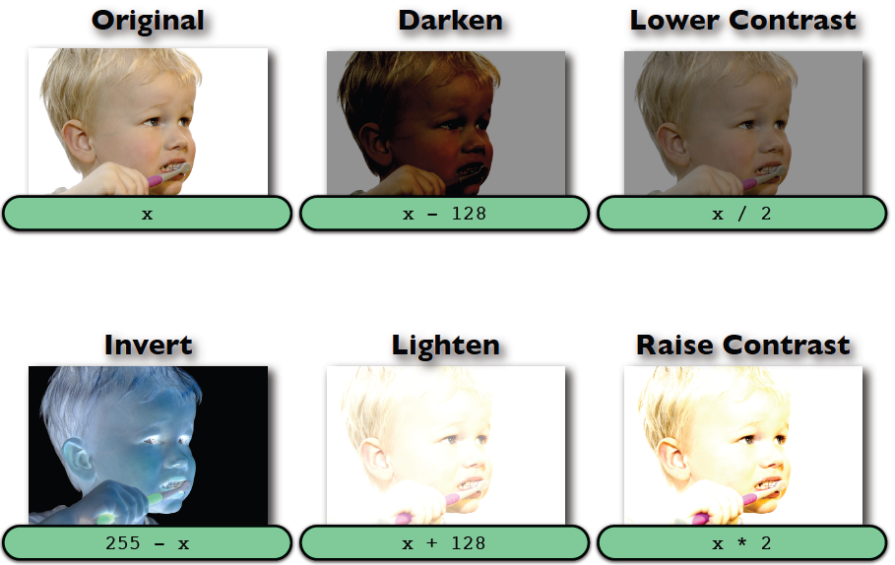
Point Processing

Slide 8
Discussion
Definition of block operations.
Give various block operators?

Slide 9
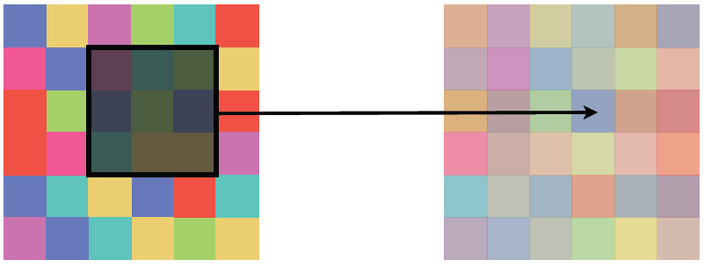
Block Operations

Slide 10
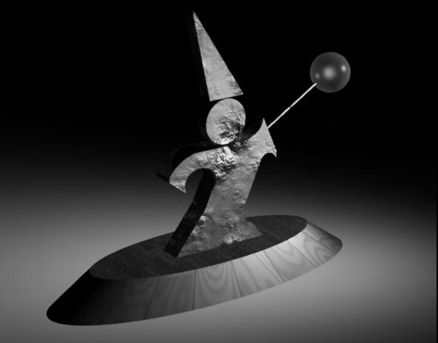
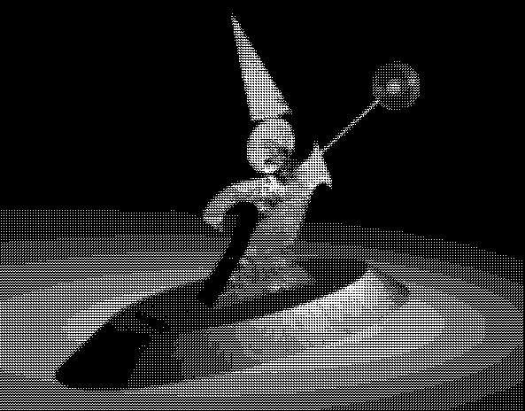
Dithering – Pattern-based

Slide 11

Dithering – Cluster

Slide 12
Discussion
Definition of neighborhood operations.
Give various neighborhood operators?

Slide 13
Neighborhood Operations

Slide 14
Discussion
What’s warping?
What’s mapping?
What’s the procedure or steps to do it?
What goal in these stages?

Slide 15
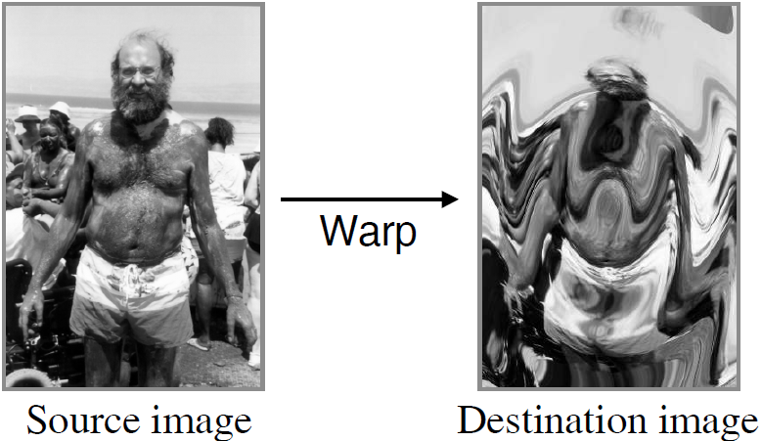
Image Warping
Move pixels of image
Mapping
Forward
Reverse
Resampling
Point sampling
Linear interpolation (lerp)
Gaussian filter

Slide 16
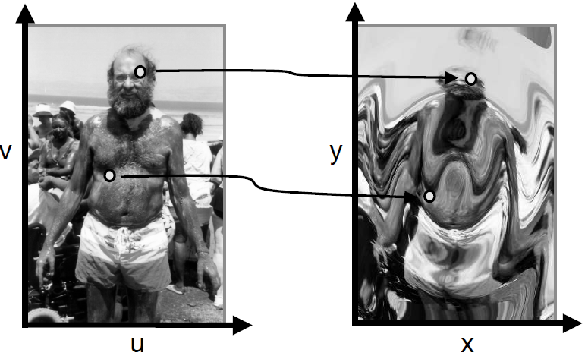
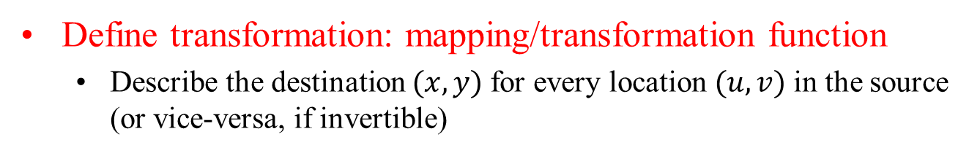
Mapping
Define transformation: mapping/transformation function
Describe the destination $(x,y)$for every location $(u,v)$in the source (or vice-versa, if invertible)

Slide 17
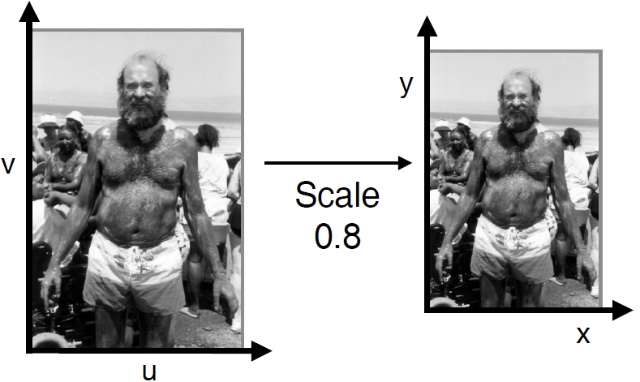
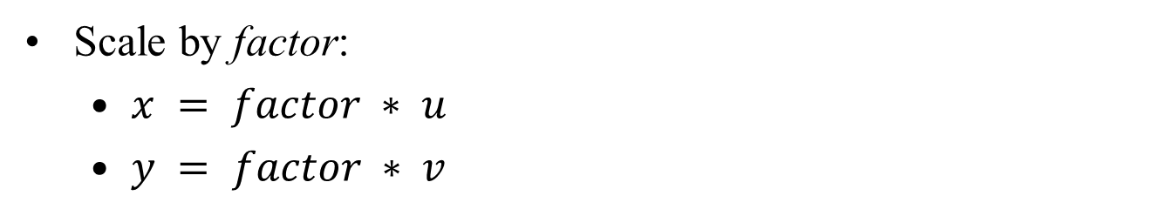
Example Mappings: Enlarge
Scale by factor:
$x = factor ∗ u$
$y = factor ∗ v$

Slide 18
Examples: Enlarging an Image
To enlarge an image, you have to add pixels between the old pixels
What values do you choose for those pixels?

Slide 19
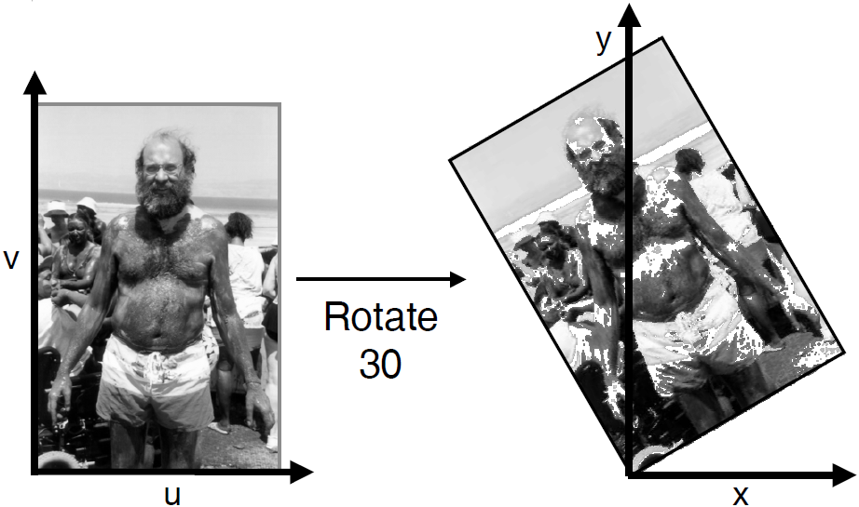
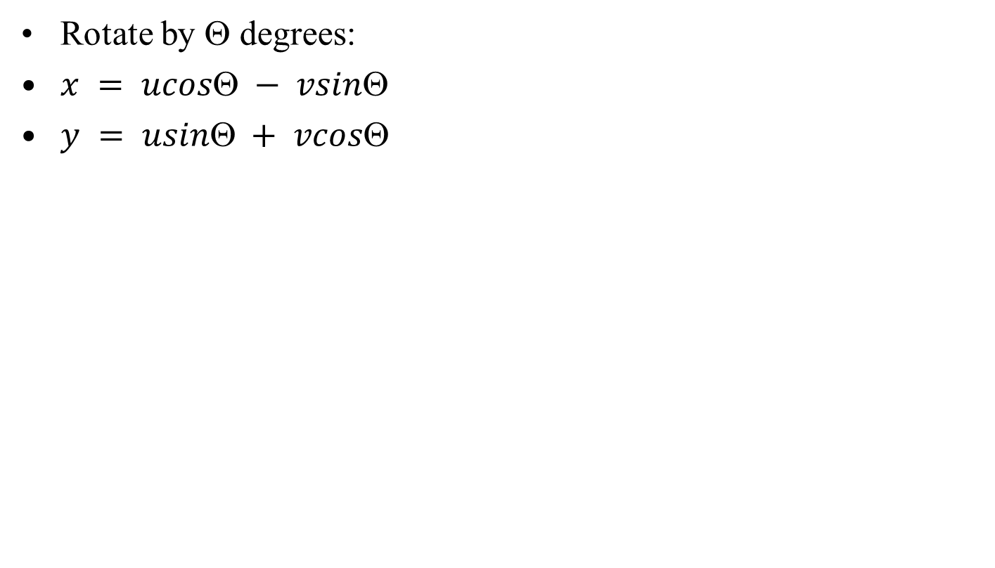
Example Mappings: Rotate
Rotate by $$ degrees:
$x = ucos − vsin$
$y = usin + vcos$

Slide 20
Examples: Rotating an Image
Pixels in the new image come from their rotated positions in the original image
These rotated locations might not be in “nice” places
Original
Need these pixels for the new image

Slide 21
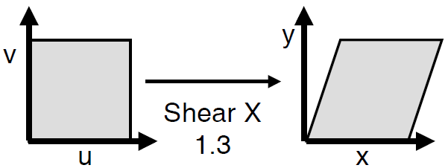
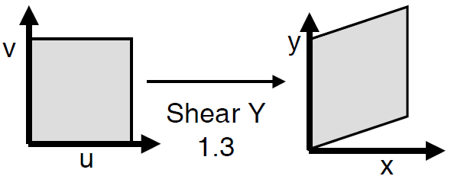
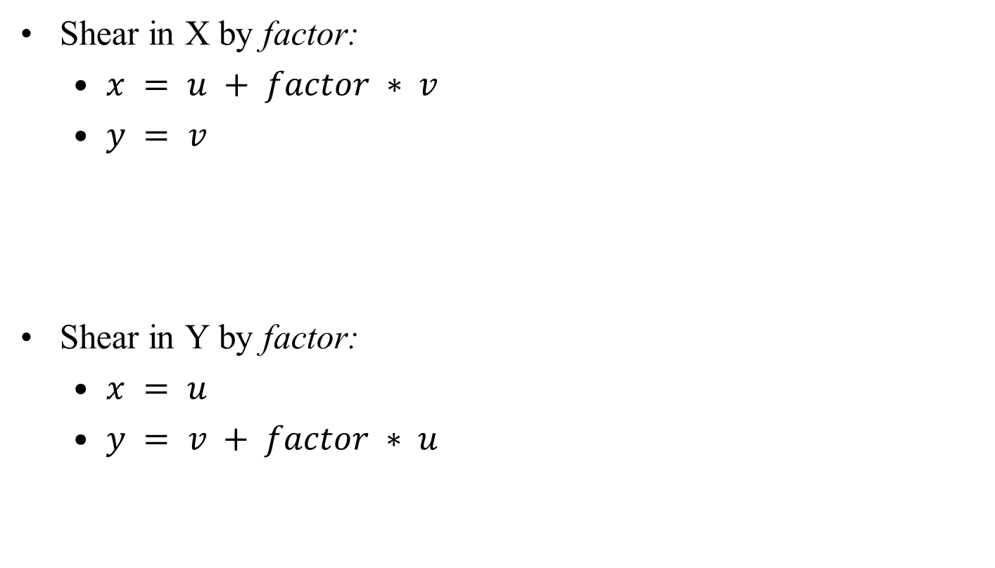
Example Mappings: Shear
Shear in X by factor:
$x = u + factor ∗ v$
$y = v$
Shear in Y by factor:
$x = u$
$y = v + factor ∗ u$

Slide 22
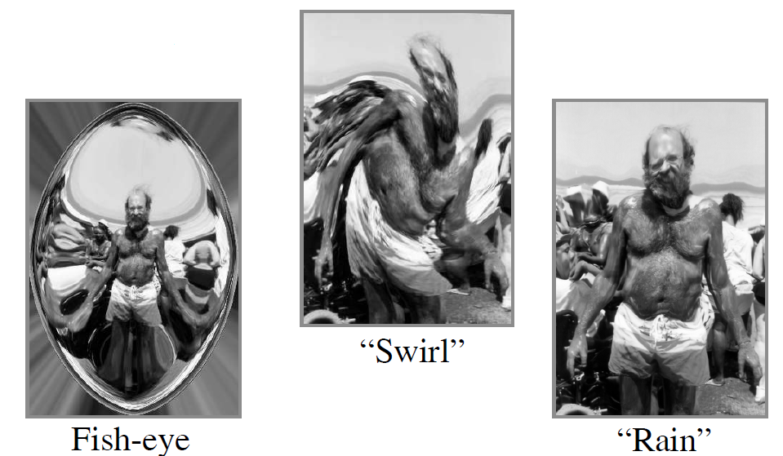
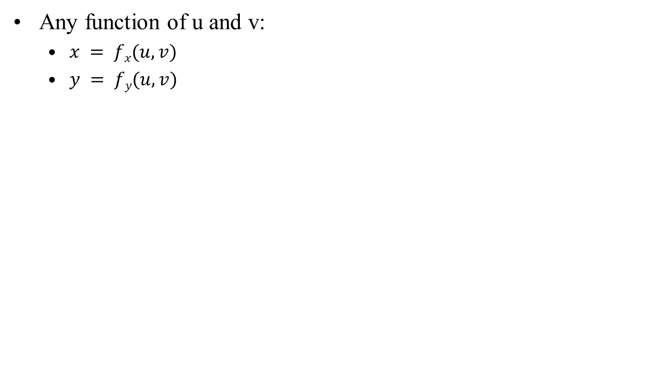
Other Mappings
Any function of u and v:
$x = fx(u,v)$
$y = fy(u,v)$

Slide 23
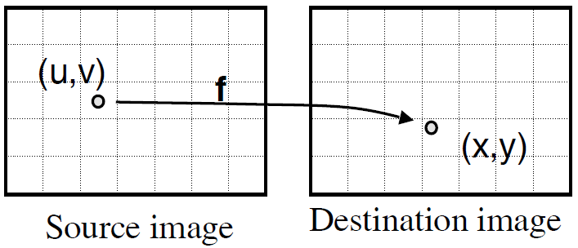
Implementation: Forward Mapping
for (int u = 0; u < umax; u++) {
for (int v = 0; v < vmax; v++) {
float x = fx(u,v);
float y = fy(u,v);
dst(x,y) = src(u,v);
}
}

Slide 24
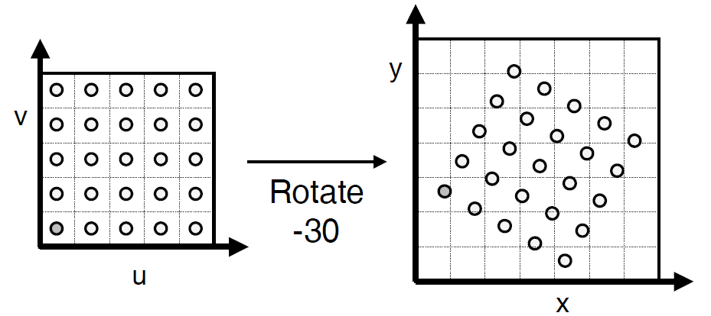
Forward Mapping
Iterate over source image

Slide 25
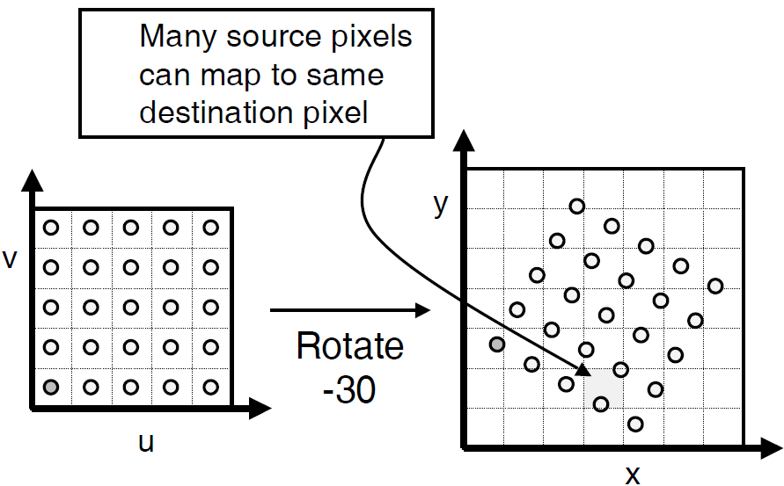
Forward Mapping - NOT
Iterate over source image

Slide 26
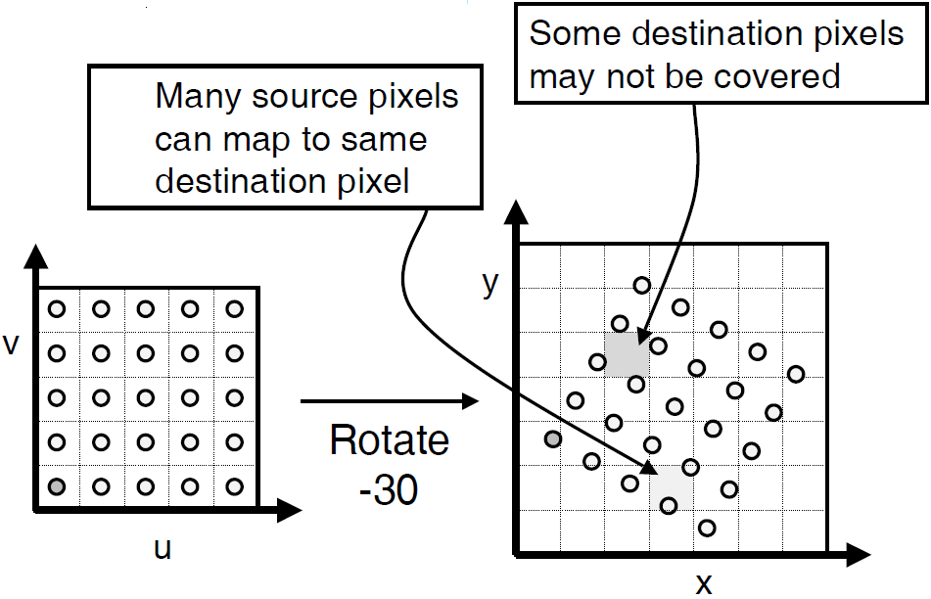
Forward Mapping - NOT
Iterate over source image

Slide 27
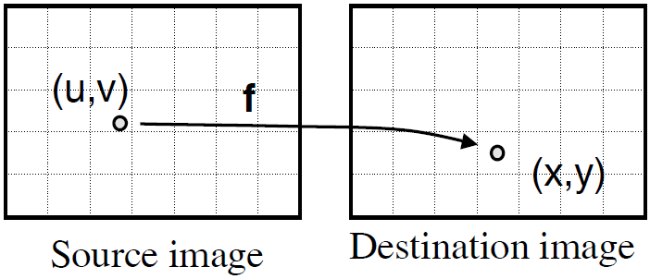
Implementation: Backward Mapping
for (int x = 0; x < xmax; x++) {
for (int y = 0; y < ymax; y++) {
float u = f_{x}⁻¹(x,y);
float v = f_{y}⁻¹(x,y);
dst(x,y) = src(u,v);
}
}

Slide 28
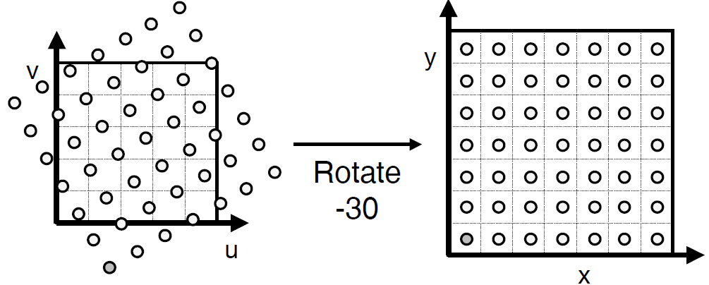
Backward Mapping
Iterate over destination image
Must resample source
May oversample, but much simpler!

Slide 29
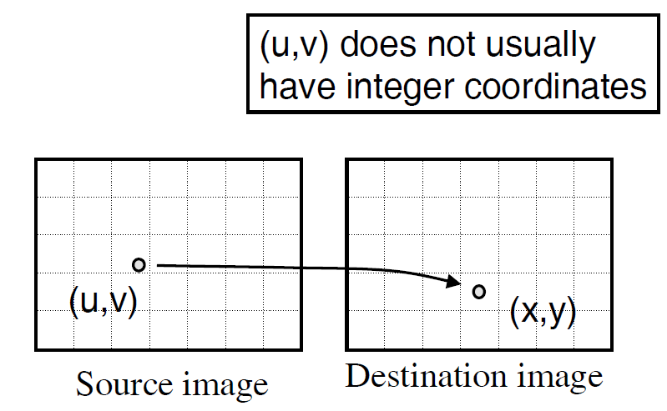
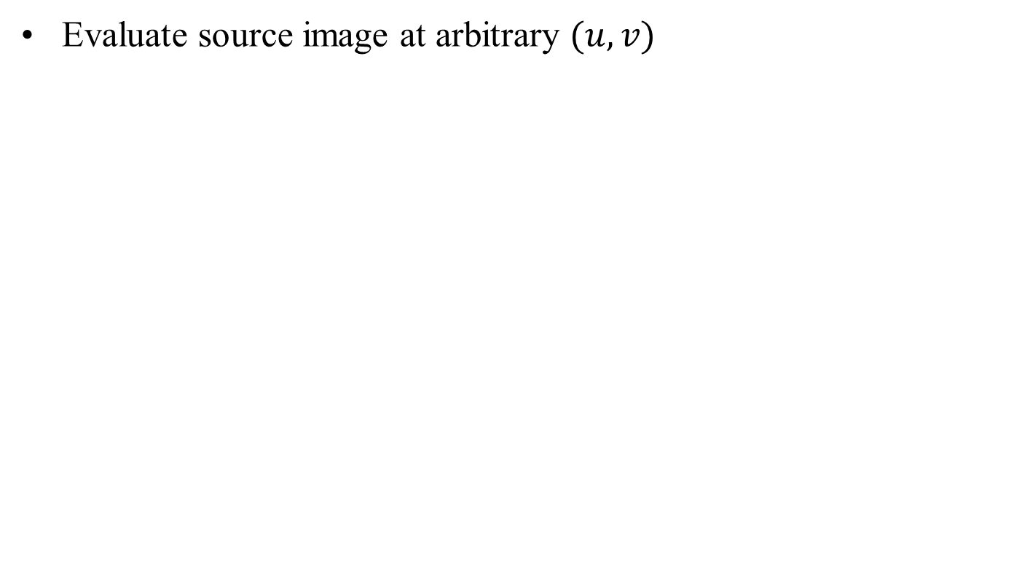
Resampling
Evaluate source image at arbitrary $(u,v)$

Slide 30
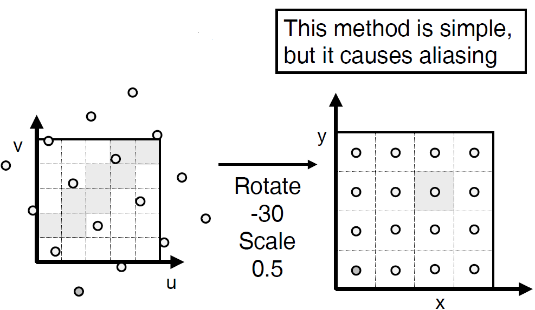
Point Sampling
Take value at closest pixel:
int iu = trunc(u+0.5);
int iv = trunc(v+0.5);
dst(x,y) = src(iu,iv);

Slide 31
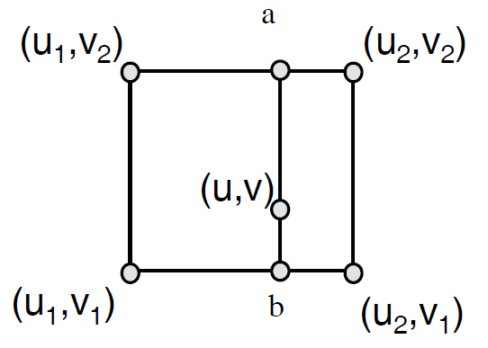
Linear Interpolation (lerp)
Bilinearly interpolate four closest pixels
a = linear interpolation of src(u₁,v₂) and src(u₂,v₂)
b = linear interpolation of src(u₁,v₁) and src(u₂,v₁)
dst(x,y) = linear interpolation of “a” and “b”

Slide 32
Implementation: Backward Mapping
for (int x = 0; x < xmax; x++) {
for (int y = 0; y < ymax; y++) {
float u = f_{x}⁻¹(x,y);
float v = f_{y}⁻¹(x,y);
dst(x,y) = src(u,v);
}
}

Slide 33

Implementation: Backward Mapping II
for (int x = 0; x < xmax; x++) {
for (int y = 0; y < ymax; y++) {
float u = f_{x}⁻¹(x,y);
float v = f_{y}⁻¹(x,y);
dst(x,y) = resample_src (u,v,w);
}
}

Slide 34
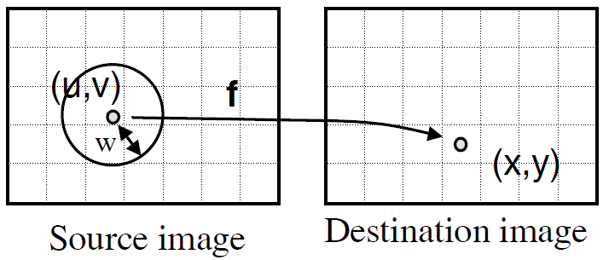
Implementation: Backward Mapping III
for (int x = 0; x < xmax; x++) {
for (int y = 0; y < ymax; y++) {
float u = f_{x}⁻¹(x,y);
float v = f_{y}⁻¹(x,y);
dst(x,y) = resample_src(u,v,w);
}
}

Slide 35
Discussion
What’s the definition of low pass filter and high pass filter?
Why we need them?
Various types?

Slide 36
Box Filter
Box filters smooth by averaging neighbors
In frequency domain, keeps low frequencies and attenuates (reduces) high frequencies, so clearly a low-pass filter
Spatial: Box
Frequency: sinc

Slide 37
Size of Filter
As a filter is localized in space, it spreads out in frequency
Conversely, as a filter is localized in frequency, it spreads out in space
A box filter is very localized in space; it has infinite extent in frequency space
A small box filter has more high frequencies than a larger box filter

Slide 38
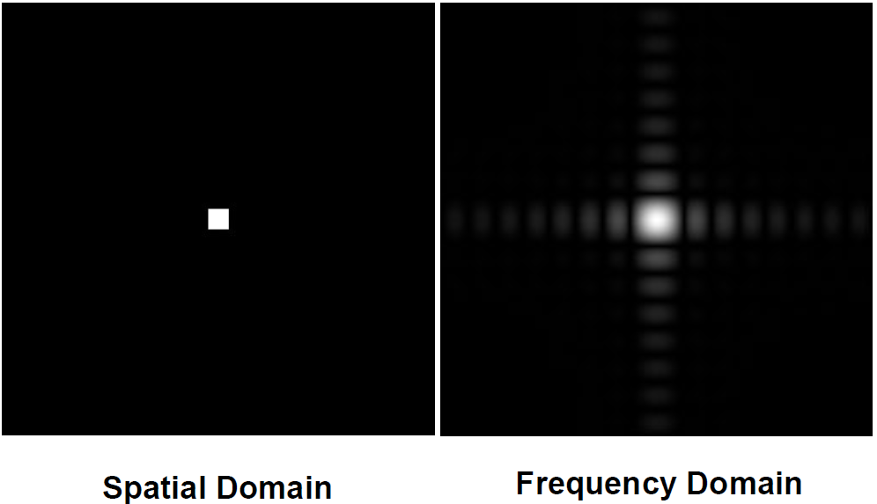
Box Filter

Slide 39
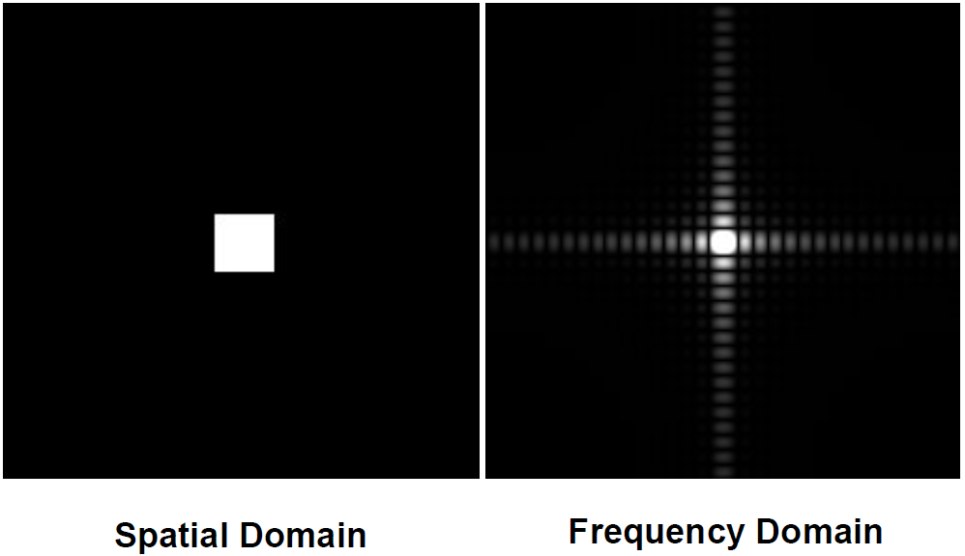
Wider Filters, Lower Frequencies

Slide 40
Efficiency?
When would it be faster to apply the filter in the spatial domain?
When would it be faster to apply the filter in the frequency domain?

Slide 41
Weighting Samples
Work in the discrete spatial domain
Convert the filter into a matrix, the filter mask or weighting mask
Move the matrix over each point in the image, multiply the entries by the pixels below, then sum
eg 3x3 box filter
Effect is averaging

Slide 42
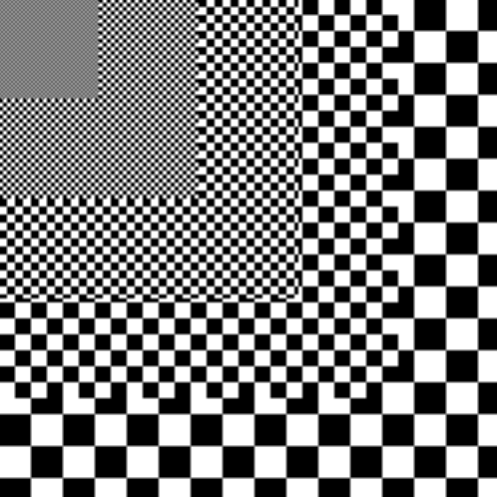
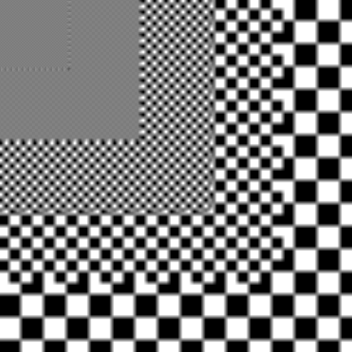
Box Filter

Slide 43
Handling Boundaries
At (0,0) for instance, you might need pixel data for (-1,-1), which doesn’t exist
Option 1: Make the output image smaller – don’t evaluate pixels you don’t have all the input for
Option 2: Replicate the edge pixels
Equivalent to: posn = x + i; if ( posn < 0 ) posn = 0; and so on for other indices
Option 3: Reflect image about edge
Equivalent to: posn = x + i; if ( posn < 0 ) posn = -posn; and similar for others

Slide 44
Bartlett Filter
Triangle shaped filter in spatial domain
In frequency domain, product of two box filters, so attenuates high frequencies more than a box
Spatial: Triangle (Box⊗Box)
Frequency: sinc²

Slide 45
Constructing Masks: 1D
Sample the filter function at matrix “pixels”, then normalize
eg 2D Bartlett
Can go to edge of pixel or middle of next: results are slightly different
1
1
3
1
5
0
1
2
1
1
2
1
4
0
1
2

Slide 46
Constructing Masks: 2D
Multiply 2 1D masks together using outer product
M is 2D mask, m is 1D mask
0.2
0.6
0.2
0.2
0.04
0.12
0.04
0.6
0.12
0.36
0.12
0.2
0.04
0.12
0.04

Slide 47
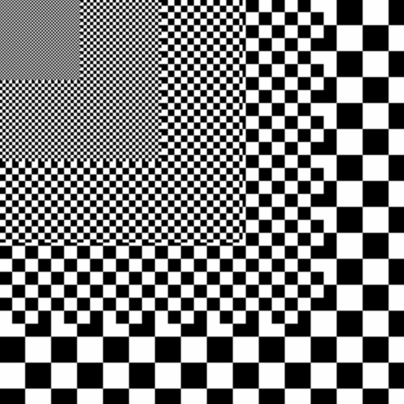
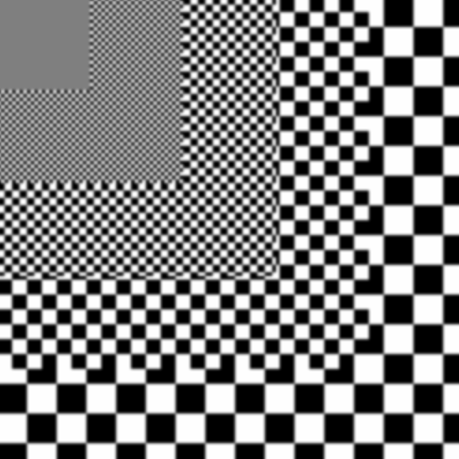
Bartlett Filter

Slide 48
Gaussian Filter
Attenuates high frequencies even further
In 2d, rotationally symmetric, so fewer artifacts

Slide 49
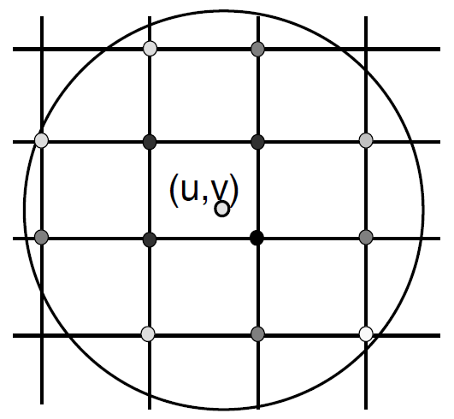
Gaussian Filtering
Compute weighted sum of pixel neighborhood:
Weights are normalized values of Gaussian function

Slide 50
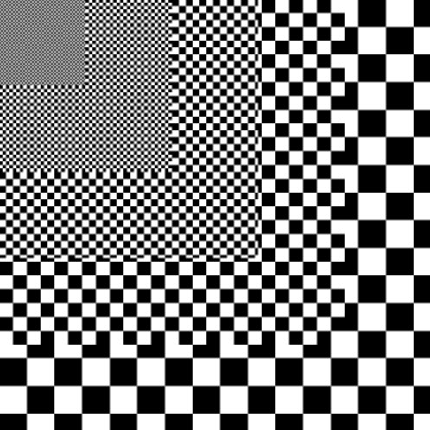
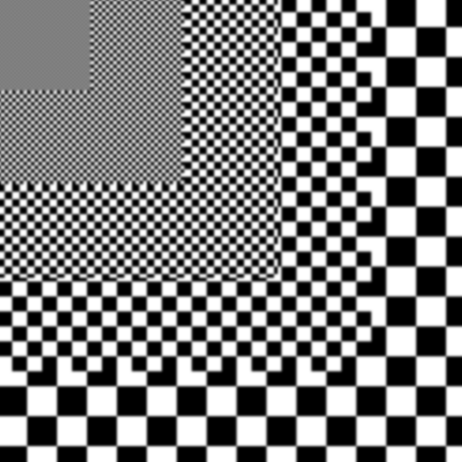
Gaussian Filter

Slide 51
Constructing Gaussian Mask
Use the binomial coefficients
Central Limit Theorem (probability) says that with more samples, binomial converges to Gaussian
1
1
2
1
4
1 1
1
1 2 1
1
4
6
4
1
16
1 3 3 1
1 4 6 4 1
1
1
6
15
20
15
6
1
64

Slide 52
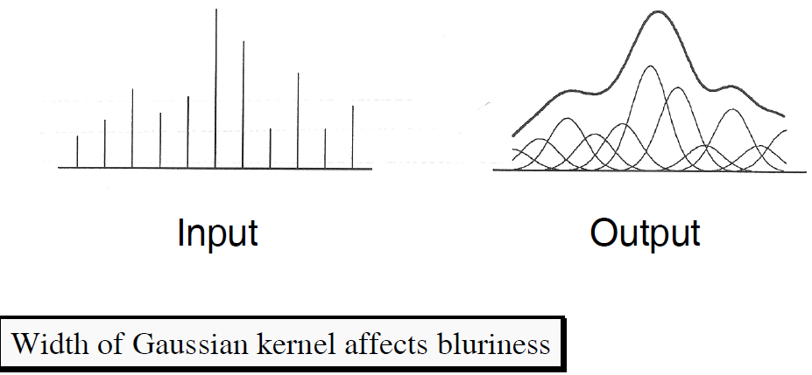
Gaussian Filtering
Convolve with Gaussian filter

Slide 53
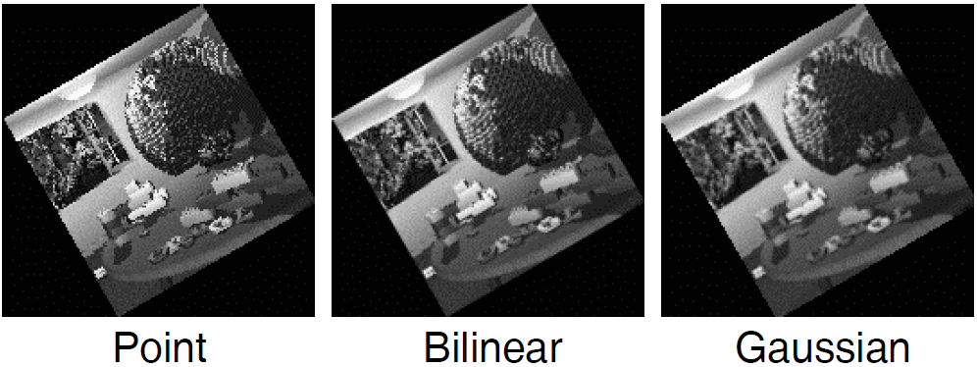
Filtering Methods Comparison
Trade-offs
Aliasing versus blurring
Computation speed

Slide 54
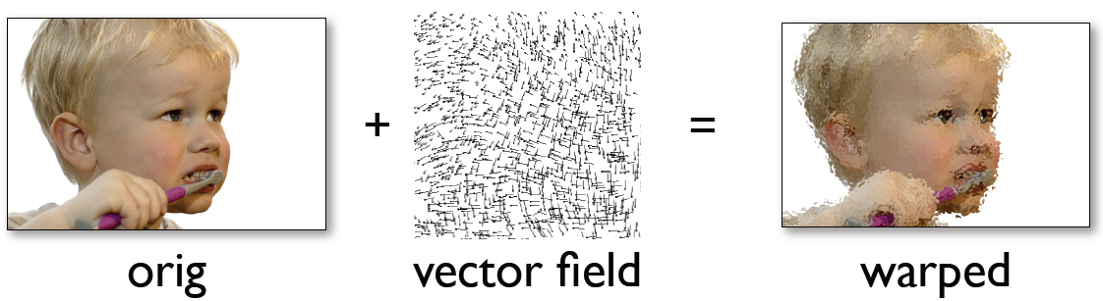
Flow-based Warped Image
how?

Slide 55
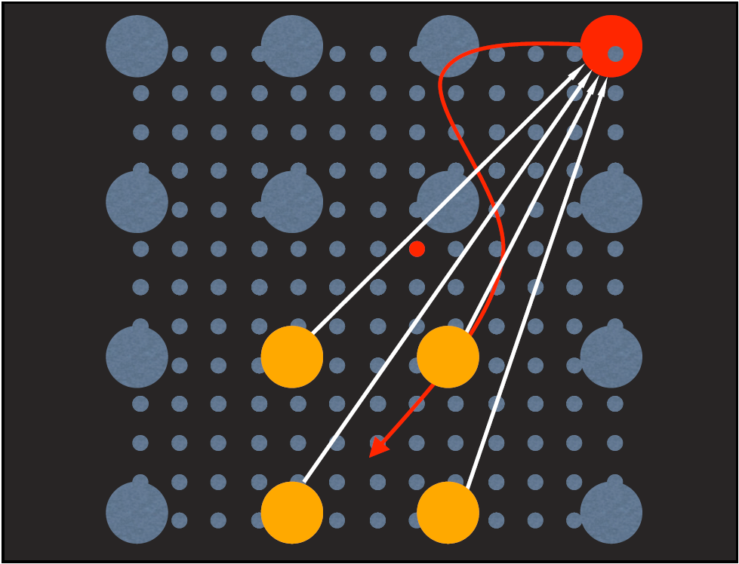
Advection (just like a fluid)

Slide 56
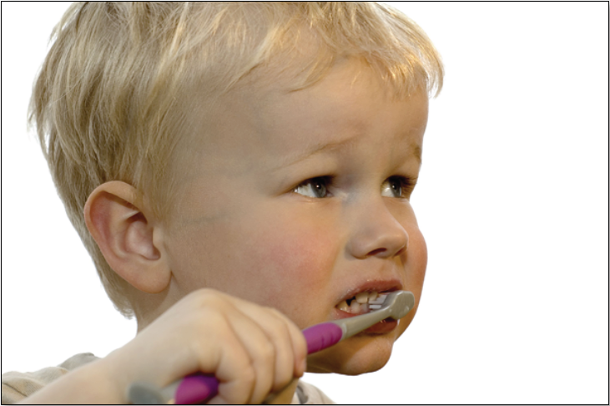
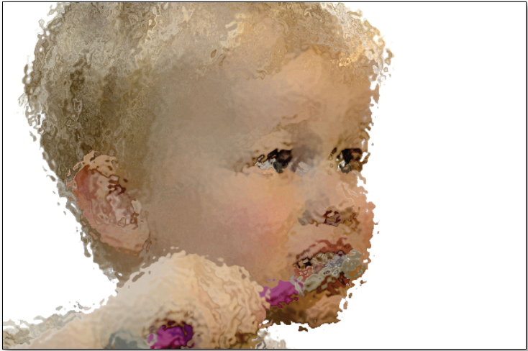
Results

Slide 57
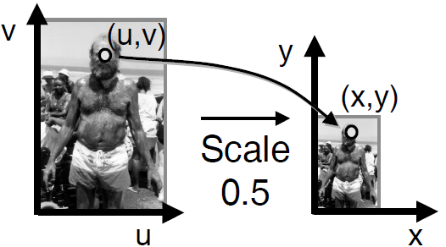
Example: Scale
Scale (src, dst, sx, sy):
float w ≅ max(1.0 / sx, 1.0 / sy);
for (int x = 0; x < xmax; x++) {
for (int y = 0; y < ymax; y++) {
float u = x / sx;
float v = y / sy;
dst(x,y) = resample_src(u,v,w);
}
}

Slide 58
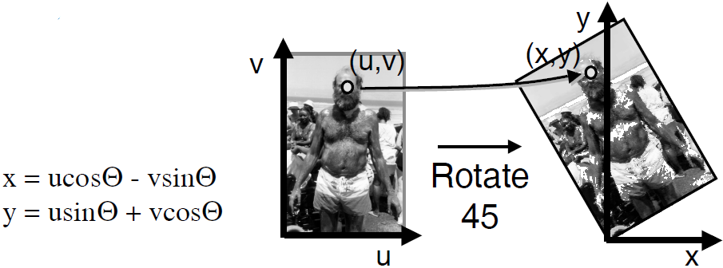
Example: Rotate
Rotate (src, dst, theta):
for (int x = 0; x < xmax; x++) {
for (int y = 0; y < ymax; y++) {
float u = x*cos(-Q) - y*sin(-Q);
float u = x*sin(-Q) + y*cos(-Q);
dst(x,y) = resample_src(u,v,w);
}
}

Slide 59
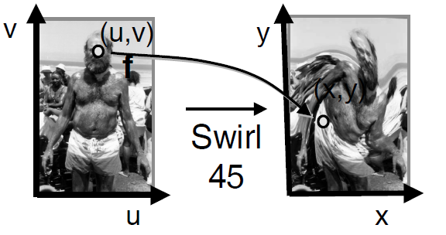
Example: Fun
Swirl (src, dst, theta):
for (int x = 0; x < xmax; x++) {
for (int y = 0; y < ymax; y++) {
float u = rot(dist(x,xcenter)*theta);
float v = rot(dist(y,ycenter)*theta);
dst(x,y) = resample_src(u,v,w);
}
}

Slide 60
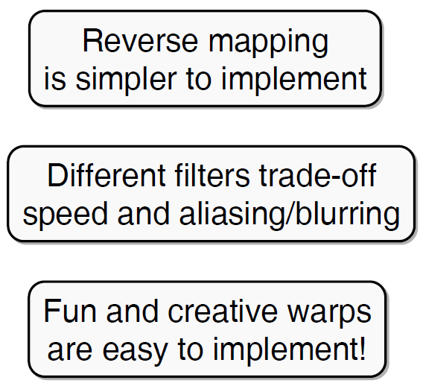
Summary of Image Warping
Mapping
Forward
Reverse
Resampling
Point sampling
Triangle filter
Gaussian filter

Slide 61
High-Pass Filters
A high-pass filter can be obtained from a low-pass filter
If we subtract the smoothed image from the original, we must be subtracting out the low frequencies
What remains must contain only the high frequencies
High-pass masks come from matrix subtraction:
eg: 3x3 Bartlett

Slide 62
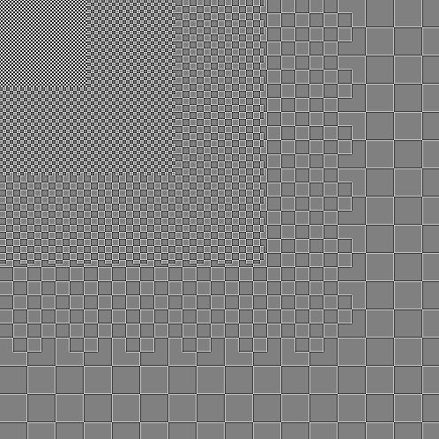

High-Pass Filter

Slide 63
Edge Enhancement
High-pass filters give high values at edges, low values in constant regions
Adding high frequencies back into the image enhances edges
One approach:
Image = Image + [Image – smooth(Image)]
Low-pass
High-pass

Slide 64

Edge-Enhance Filter

Slide 65

Edge Enhancement

Slide 66
Fixing Negative Values
The negative values in high-pass filters can lead to negative image values
Most image formats don’t support this
Solutions:
Truncate: Chop off values below min or above max
Offset: Add a constant to move the min value to 0
Re-scale: Rescale the image values to fill the range (0,max)

Slide 67
Filtering and Color
To filter a color image, simply filter each of R,G and B separately
Re-scaling and truncating are more difficult to implement:
Adjusting each channel separately may change color significantly
Adjusting intensity while keeping hue and saturation may be best, although some loss of saturation is probably OK

Slide 68
Original Image

Slide 69

Shifted Image

Slide 70
Original Image

Slide 71

X-Edge Detection

Slide 72

Y-Edge Detection

Slide 73

General Edge Detection
Can this be described as a convolution?

Slide 74
Original Image

Slide 75

Blurred Image

Slide 76

Blurring Filters

Slide 77

Image Filtering: Blurring

Slide 78
Blurred Image

Slide 79

Sharpened Image

Slide 80
Original Image

Slide 81

Sharpened Image

Slide 82

Original

Slide 83

Noise

Slide 84

Blurred Noise

Slide 85

Median Filter
Can this be described as a convolution?

Slide 86
Original Image

Slide 87

Example: Noise Reduction

Slide 88

Example: Noise Reduction

Slide 89
Discussion
What’s the definition of transformation?
What and how translation?
What and how rotation?
What and how affine transformation?
What and how perspective transformation?

Slide 90
Image/2D Transformations

Slide 91
Image Transformations
Image warping: change domain of image
g(x) = f(T(x))
f
f
T
x
x
Image filtering: change range of image
g(x) = T(f(x))
f
f
T
x
x

Slide 92

Image Transformations
Image warping: change domain of image
g(x) = f(T(x))
f
g
T
Image filtering: change range of image
g(x) = T(f(x))
f
g
T

Slide 93




Parametric (global) warping
translation
rotation
aspect
perspective
affine
cylindrical
Examples of parametric warps:

Slide 94
Parametric (global) warping
T
p = (x,y)
p’ = (x’,y’)
Transformation T is a coordinate-changing machine:
p’ = T(p)
What does it mean that T is global?
Is the same for any point p
can be described by just a few numbers (parameters)
Let’s represent T as a matrix:
p’ = Mp

Slide 95

Warp + Crossfade

Slide 96

Warp Example

Slide 97

Morphing Example

Slide 98
Discussion
How to draw a water color image?
How to draw a oil painting?
How to automate the transformation from a photo to a water color image?

Slide 99


Painterly Filters
Many methods have been proposed to make a photo look like a painting
Today we look at one: Painterly-Rendering with Brushes of Multiple Sizes
Basic ideas:
Build painting one layer at a time, from biggest to smallest brushes
At each layer, add detail missing from previous layer

Slide 100
Algorithm 1
function paint(sourceImage,R₁ ... R_{n}) // take source and several brush sizes
{
canvas := a new constant color image
// paint the canvas with decreasing sized brushes
for each brush radius R_{i}, from largest to smallest do
{
// Apply Gaussian smoothing with a filter of size const * radius
// Brush is intended to catch features at this scale
referenceImage = sourceImage * G(fs R_{i})
// Paint a layer
paintLayer(canvas, referenceImage, Ri)
}
return canvas
}

Slide 101
Algorithm 2
procedure paintLayer(canvas,referenceImage, R) // Add a layer of strokes
{
S := a new set of strokes, initially empty
D := difference(canvas,referenceImage) // euclidean distance at every pixel
for x=0 to imageWidth stepsize grid do // step in size that depends on brush radius
for y=0 to imageHeight stepsize grid do {
// sum the error near (x,y)
M := the region (x-grid/2..x+grid/2, y-grid/2..y+grid/2)
areaError := sum(D_{i,j} for i,j in M) / grid²
if (areaError > T) then {
// find the largest error point
(x1,y1) := max D_{i,j} in M
s :=makeStroke(R,x1,y1,referenceImage)
add s to S
}
}
paint all strokes in S on the canvas, in random order
}

Slide 102


Results
Original
Biggest brush
Medium brush added
Finest brush added

Slide 103
Painting Illustrations (One Layer)
The movement of averaging computation

Slide 104
Painting Illustrations (One Layer)
Randomize the averaging window position

Slide 105
Painting Illustrations (One Layer)
Randomize the order
Zig-zag order
Random order

Slide 106
Painting Illustrations (One Layer)
Other randomized techniques
Randomize the picking color

Slide 107

Point Style
Uses round brushes
We provide a routine to “paint” round brush strokes into an image for the project

Slide 108
Project 1
Due and demo at Oct. 13.
Implement a basic image editing program – Photoshop lite
The web site is long and detailed
Look for hints and notes on implementation on the web site
Start early: you have enough information to implement several operations already
Keep an eye out for hints and clarifications on the class mailing list

Slide 109
Project 1 Grading
Read very carefully the requirements for grading
You have to do the demo to show us your work at Oct. 13.
We will not tolerate programs that don’t compile or run
The aim is to implement 100 points worth of options
Different options have different point values
Some options are harder than others
The value of some options depends on whether you do other, similar options

